Slide 1
Stat 495r – Presenting Data
Week 6 - ggplot

Slide 2
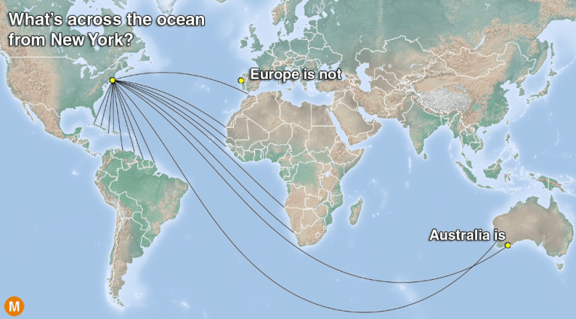
Data Viz #1

Slide 3
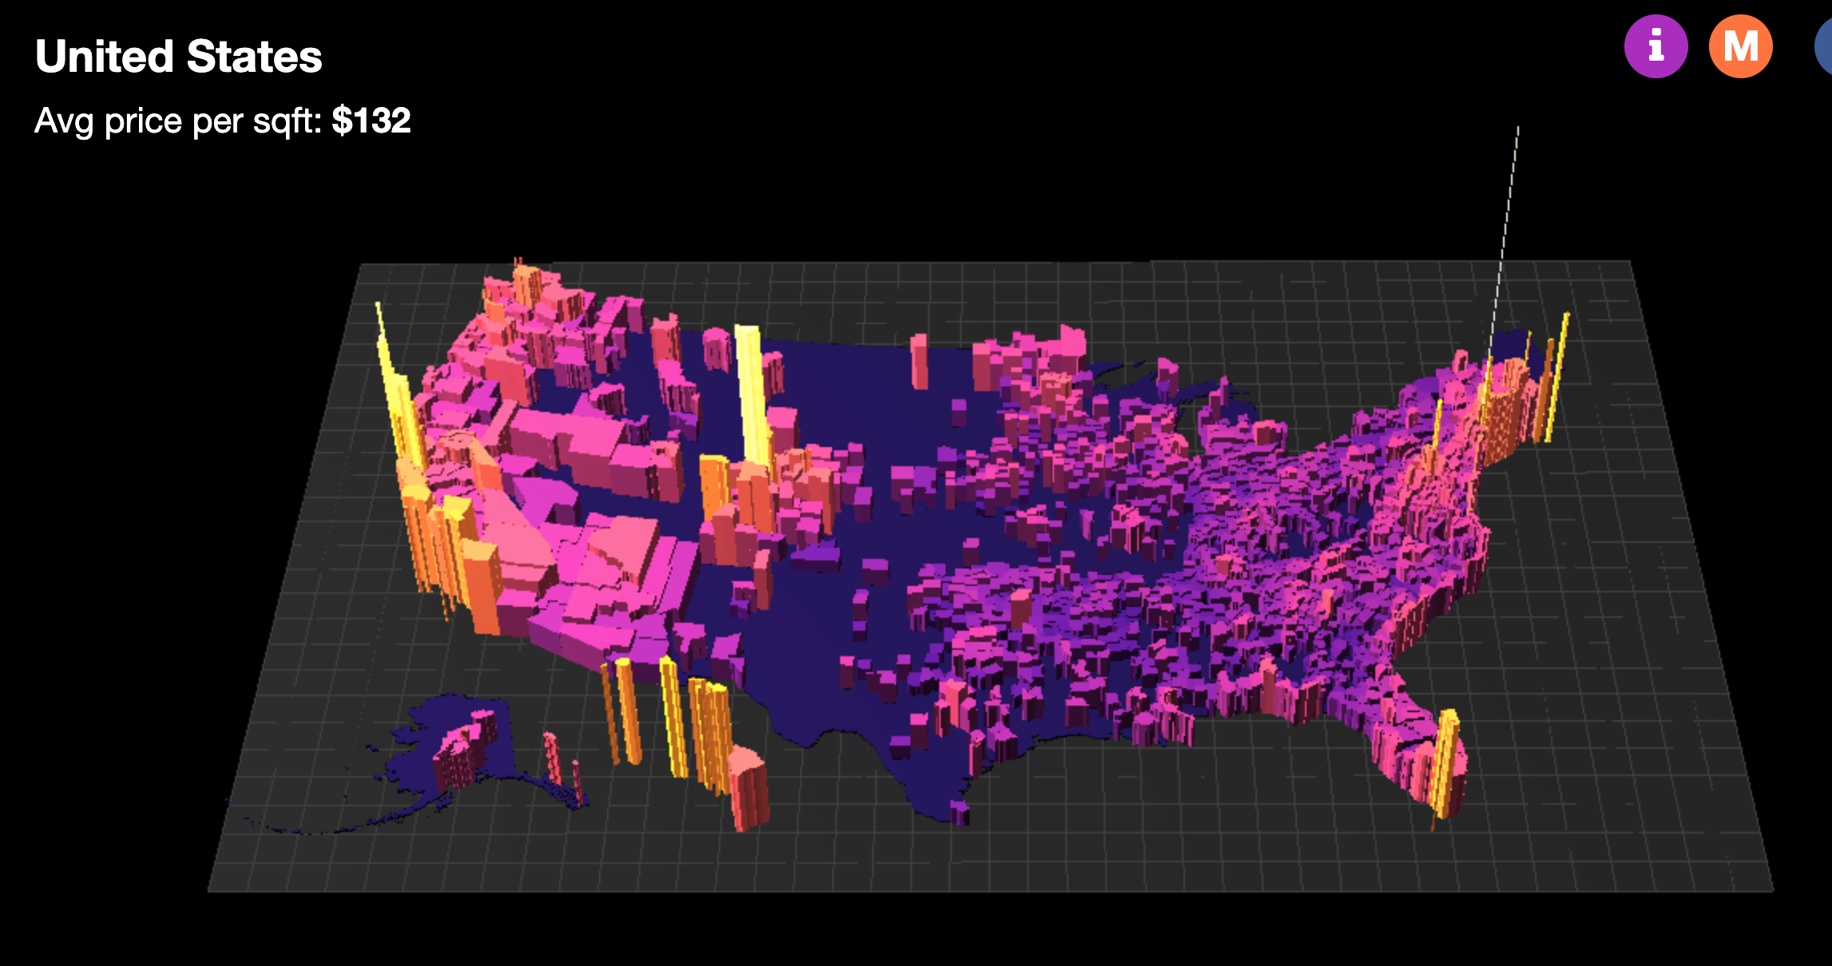
Data Viz #1

Slide 4
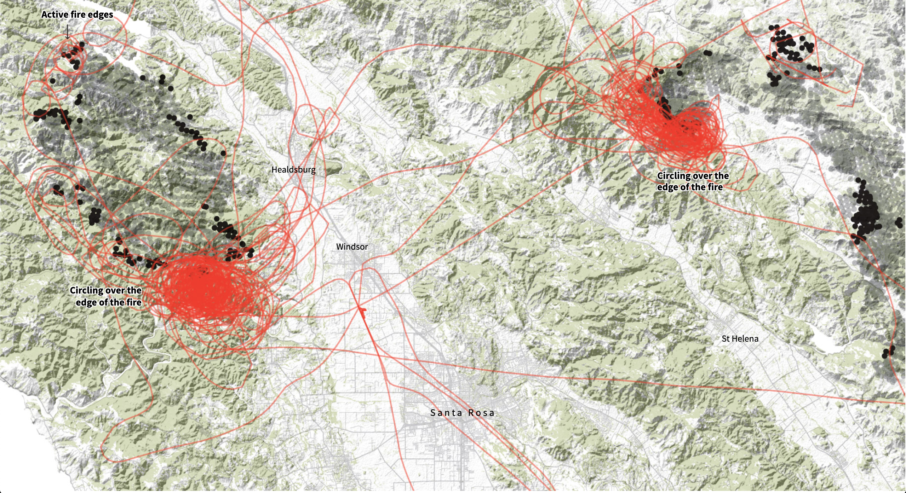
Data Viz #1

Slide 5

Quote of the Week
It can be a little disorienting to learn a programming language like R, mostly because at the beginning there seem to be so many pieces to fit together for things to work properly. It can seem like you have learn everything before you can do anything. The language has some possibly unfamiliar concepts that define how it works, like “object,” ”function,” or “class.” The syntactic rules for writing code are annoyingly picky. Error messages seem obscure; help pages terse; other people have had not quite the same issue as you...
...Don’t panic. You have to start somewhere.

Slide 6
Homework 4 and 5

Slide 7
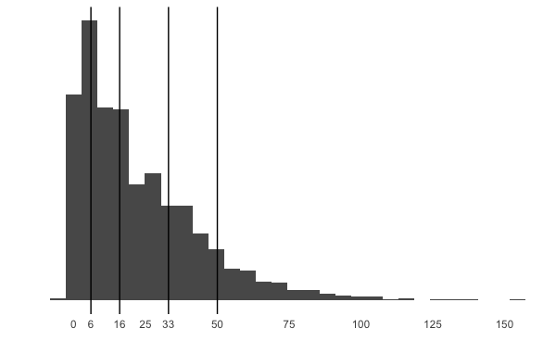
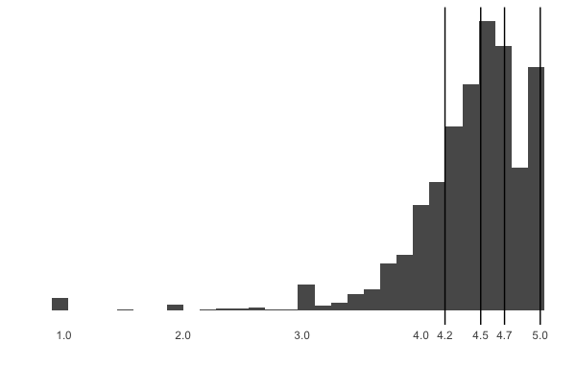
Moving forward, quarterly commissions will be based off of customer responses to the satisfaction question instead of the NPS question
Former Bonus Calculation (NPS)
New Bonus Calculation (CSAT)
Q: If you were in charge of hiring SolarMax's SunPower Technicians, how likely would you be to hire the professional who came to your home today? (0 to 10)
Calculation: # of promoters (9,10) - # of detractors (0-7)
Q: Overall, how satisfied were you with the service/install you received today? (1 to 5)
Calculation: Average
50%
75%
25%
90%
<25%
25%
50%
75%
90%
<25%
Quantile (Ranking %) | Bonus (% of Pay)
<25% | No bonus
25% (6) | 5%
50% (16) | 10%
75% (33) | 15%
90% (5) | 25%
Quantile (Ranking %) | Bonus (% of Pay)
<25% | No bonus
25% (4.2) | 5%
50% (4.5) | 10%
75% (4.7) | 15%
90% (5) | 25%
NPS
CSAT

Slide 8
Sharing of Personal Vizzes

Slide 9
R Overview

Slide 10



R is statistical programming language used often by data scientists for analysis, modeling and visualization
Programming Language
IDE – Integrated Development Environment
Demonstration of using R programmatically

Slide 11
Review
Panels in Rstudio
Everything is an object (class)
Assignment – everything has a name
You use functions, which take arguments
Functions come in packages (libraries)
Take notes by commenting
RScripts are common, but there are some special ones
Load your packages
Read in your data
Munge your data
Visualization your data

Slide 12
ggplot

Slide 13
Key Takeaways
Ggplot works best with “tidy data”
You specify the mapping (encoding) of the data to different aesthetics (channels) and plot the geometrics objects/geoms (marks)
You build things layer by layer
You can map aesthetics, but you can also set them
Different geoms take different aesthetics
Saving your work

Slide 14
p <- ggplot(data = <data>,
mapping = aes(<aesthetic> = <variable>,
<aesthetic> = <variable>,
<...> = <...>)) +
geom_<type>(<...>) +
scale_<mapping>_<type>(<...>) +
coord_<type>(<...>) +
labs(<...>) +
<theme>
Needed: data, aesthetic mappings, geoms
Defaults: some aesthetics, scales, coordinate plan, labels

Slide 15
Things to do
Demonstrate the cascading mappings
Grouped aesthetic
Doing facets
Fill versus color
Dodge versus stacked bar charts
Coordinate planes
Adding data labels
Changing theme elements
Using scales
Using ggthemes
Using ggrepel

Slide 16
Activity

Slide 17
Activity
Team up
Use the gapminder data to recreate one of the visuals
Gapminder data available in the `gapminder` package
Change the theme, scales, etc.

Slide 18
Homework

Slide 19
Homework 1
In Week 5, you replicated a visual in ggplot – now make it look pretty
Grading criteria:
Theme elements
Axis scales
Colors
Axis limits
Titles and other text

Slide 20
Homework 2
Find a political claim
Make a data visualization that refutes/supports that political claim
Reference any articles that include your data/visual

